Slide 1

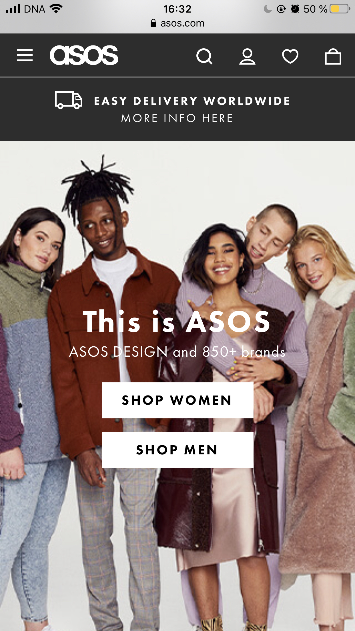

Case company study

Slide 2
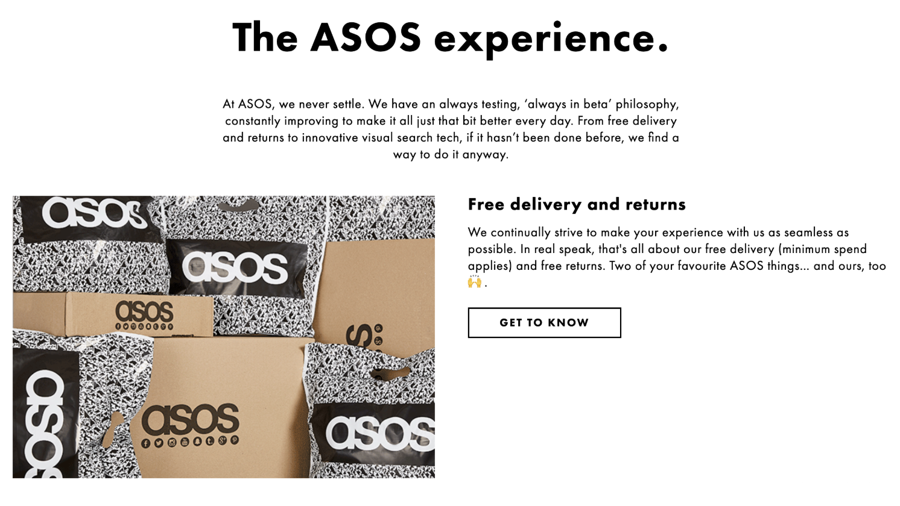
As Seen On the Screen

Slide 3

ASOS briefly
British online fashion and cosmetic retailer
Founded in 2000 in London
Ships to all 196 countries

Slide 4

European brand
Focus on streamlining logistics and automating warehouse technologies
Worldwide force

Slide 5
4
3
2
1
ASOS works with
2
million garments/year

Slide 6
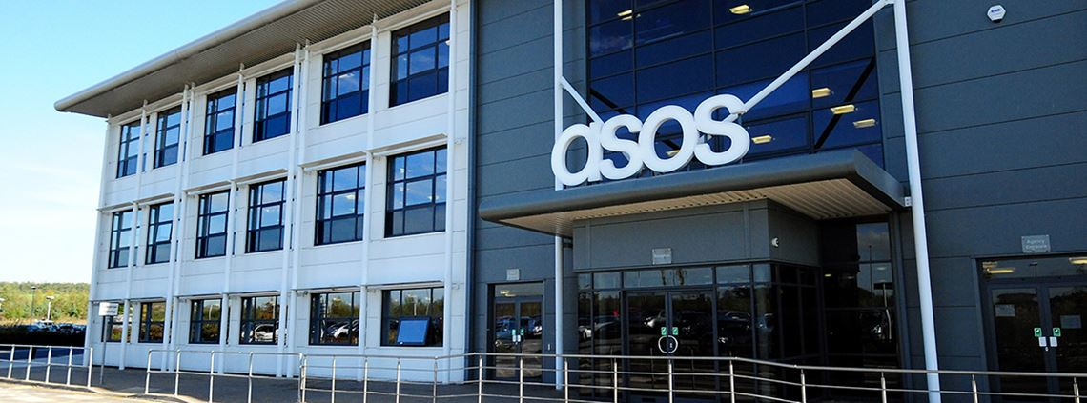
80 000 square meters of warehouses = 13 football pitches

Slide 7
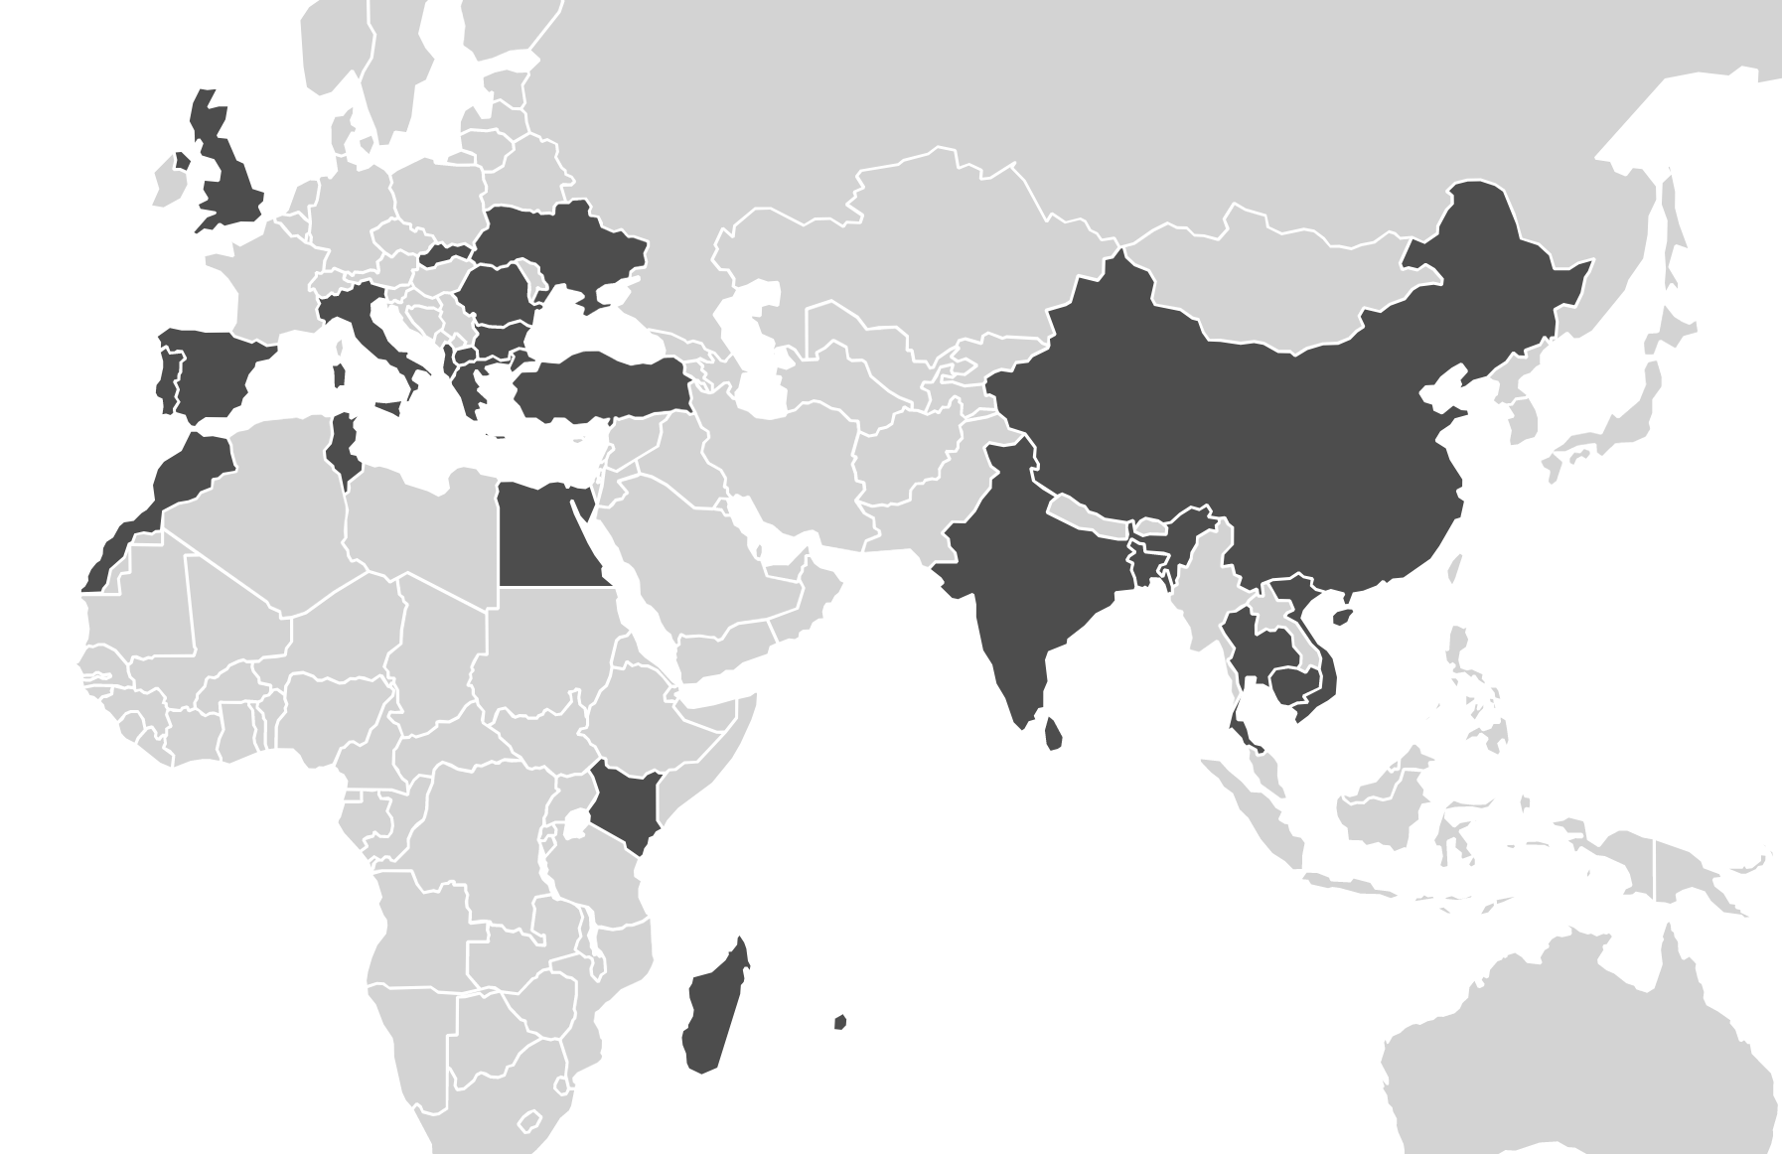


The biggest manufacturers
China
No of workers 24 864
No of factories 254
% Male workers 40
% Female workers 60
India
No of workers 38 514
No of factories 228
% Male workers 67
% Female workers 33
Vietnam
No of workers 14 764
No of factories 22
% Male workers 31
% Female workers 69

Slide 8



“We can’t manage what we don’t know”
Mapping cotton, viscose and leather supply chains
Regular meetings with suppliers
Transparency

Slide 9
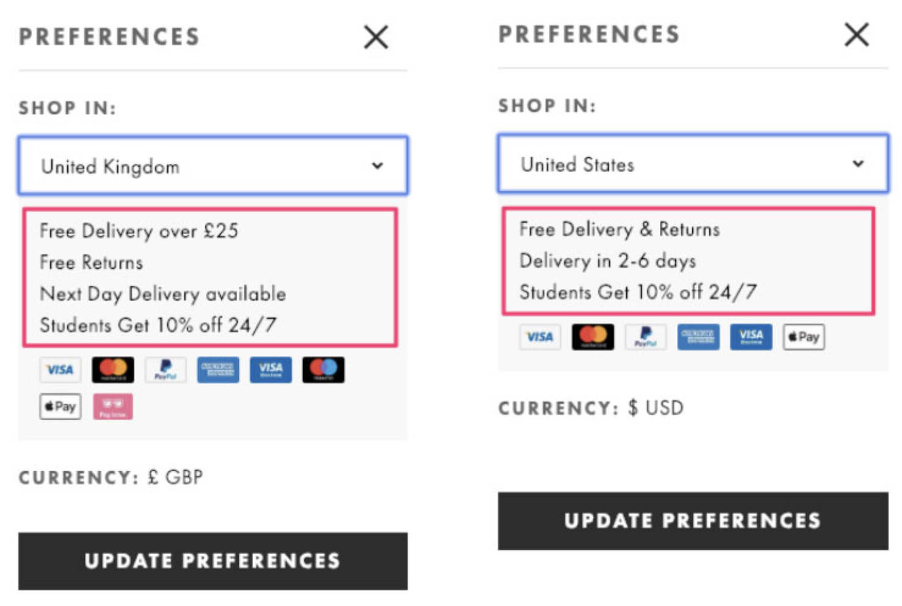
Competitive advantage
Free same and next day shipping and returns

Slide 10

Highlighting unique selling points
Notifying customers on experience they can expect, ads emphasize worldwide, free shipping and free returns

Slide 11
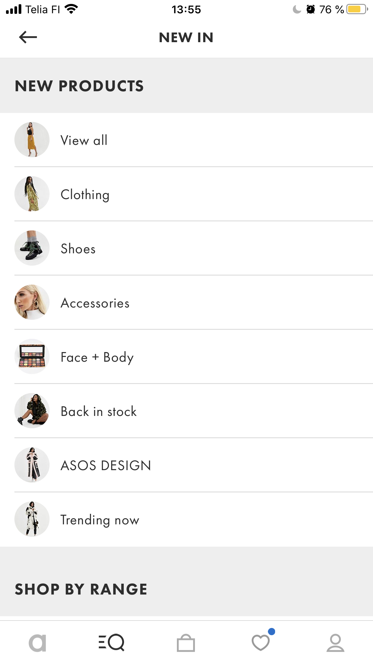

More and more access to the ASOS' ever-expanding inventory is given to customers
12,4 million active users

Slide 12
4 000
3 999
3 998
3 997
3 996
3 995
items are added every week

Slide 13
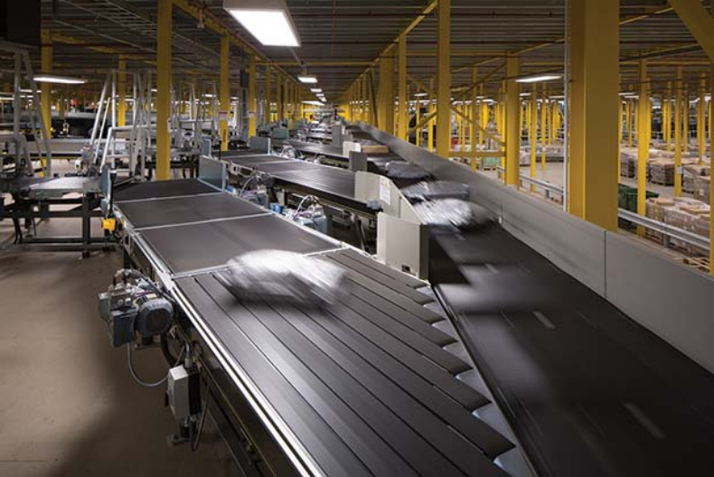

Investing in warehouse and shipping logistics
Setting a midnight cutoff for next-day shipping almost every day of the week

Slide 14
ASOS captures the exact size and weight of each order in packaging bench
This information + destination of the order are sent to the MetaPack, a software, which automatically defines what documents are needed in the custom

Slide 15
ASOS has the capacity to despatch over 10 million shipments per week and process nearly 3.5 returns
It also has over 60,000 pick-up-drop-off locations globally

Slide 16

Personalized shopping experience
A service called Precise gives the customer…
Ability to choose their preferred shipping times
Control and choice over how and when their parcels arrive

Slide 17
We are all yours now

Slide 18
References
ASOS 2020. Sustainable Sourcing Programme. https://www.asosplc.com/corporate-responsibility/our-products/sustainable-sourcing-programme. Accessed on 4 March 2020.
ASOS 2020. Our Supply Chain. https://www.asosplc.com/corporate-responsibility/our-products/our-supply-chain. Accessed on 4 March 2020.
Hollis, S. 2019. How ASOS uses warehouse technology to differentiate their brand. https://jilt.com/blog/asos-shipping-logistics/. Accessed on 4 March 2020.
SHD LOGISTICS 2019. ASOS profits plunge as logistics projects ramp up. https://www.shdlogistics.com/news/asos-profits-plunge-logistics-projects-ramp. Accessed on 15 March 2020.

